Slide 1
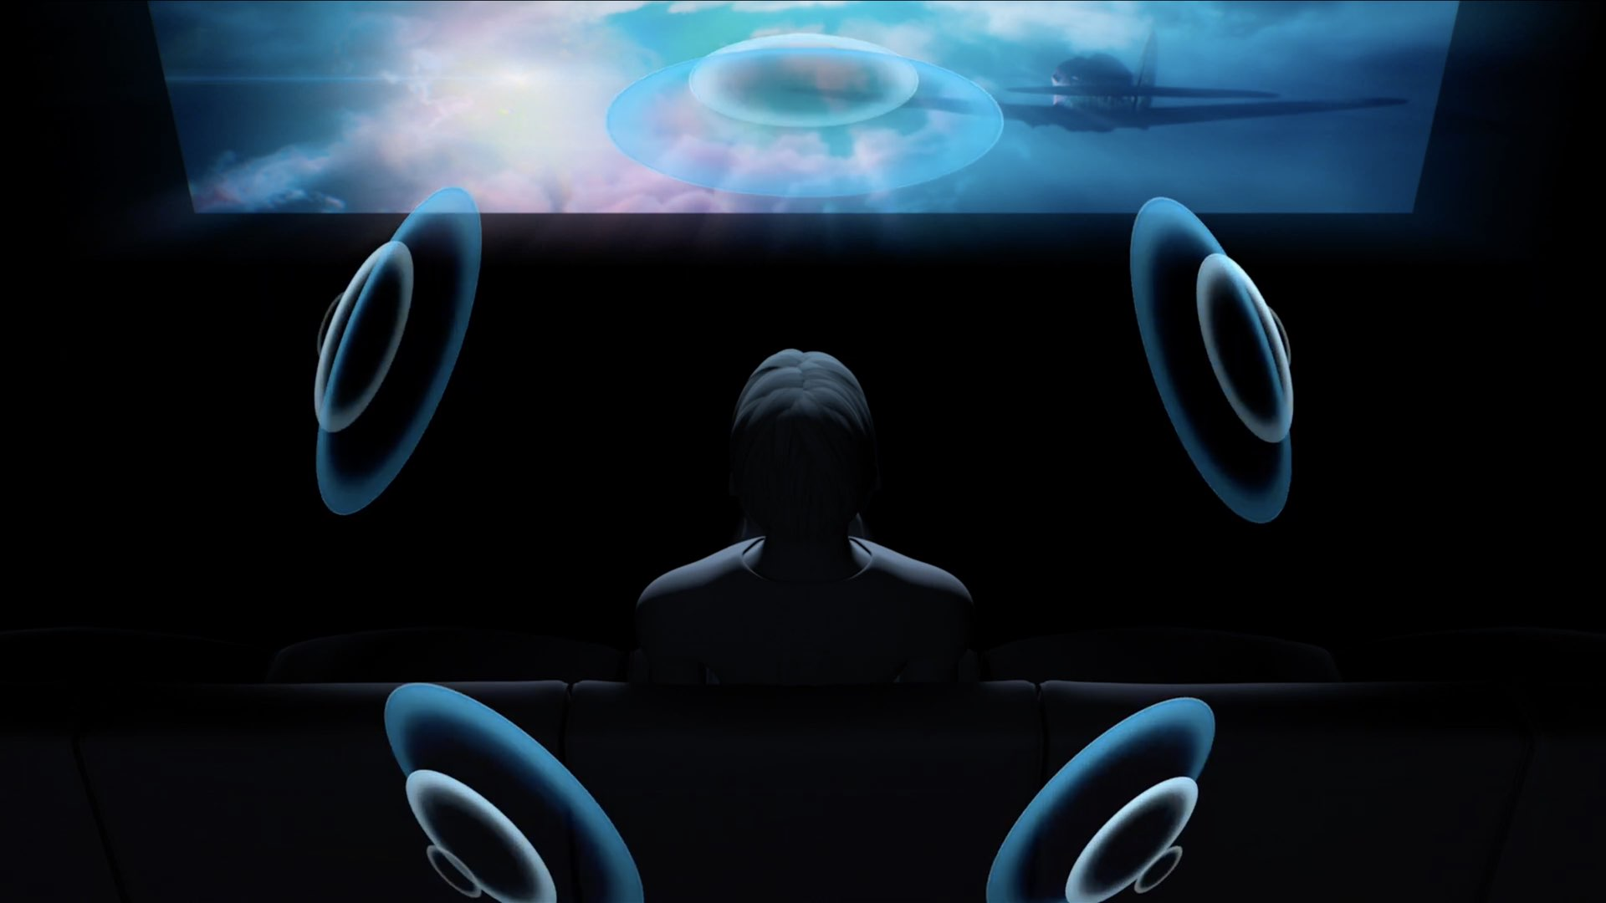
Spatial Audio in the Web Audio API

Slide 2
Spatial panning
Probably the most complicated built-in operation in the Web Audio API
All about determining how source is heard given geometry of a situation
Requires source to be panned
PannerNode: gives panning attributes for the source
Like other nodes
var myPanner = new PannerNode(context, options);
Or
var myPanner = context.createPanner();
Listener to receive source
AudioListener: gives attributes of the listener
Only one listener in an audio context
Both PannerNode and AudioListener have lots of parameters

Slide 3
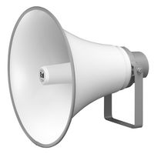
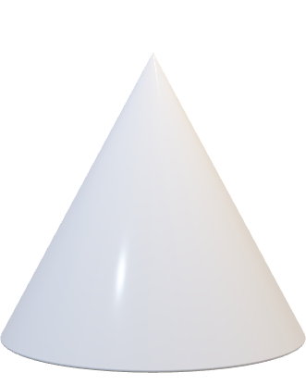
Position, orientation, directivity
Spatialisation determined by
AudioListener
Position
Up and Forward direction
Panner nodes
Position
Orientation
Sound cone
Distance model
Panning model
y
Up
AudioListener
Forward
x
Orientation
z
PannerNode
Sound cone
Notes:
This is the big, summary picture

Slide 4
Right-hand coordinate system
Y
Everything in WAA’s spatial audio is in a right-hand coordinate system
X: horizontal
Y: vertical
Z: back and forth
(0,1,0)
(1,0,0)
X
Right hand
(0,0,1)
Z

Slide 5
AudioListener
Listener’s up vector; direction of top of listener’s head
Up and front vectors are orthogonal
Listener’s position vector
Listener’s front vector; direction listener is facing
Origin of coordinate system

Slide 6
AudioListener
var myListener = context.listener; myListener.positionX.value = 1;
positionX/positionY/positionZ
horizontal/vertical/longitudinal (back & forth) position of listener. default 0,0,0
forwardX / forwardY / forwardZ
horizontal/vertical/longitudinal (back & forth) position of listener's forward direction. default is 0,0,-1.
upX / upY / upZ
horizontal/vertical/longitudinal (back & forth) position of top of listener's head. default is 0,1,0.

Slide 7
PannerNode
positionX/Y/Z: position of audio. Default is 0,0,0
orientationX/Y/Z: position of audio source's vector. Default is 1,0,0
coneInnerAngle/coneOuterAngle: cone angle range for volume reduction
coneOuterGain: reduction outside cone
refDistance/maxDistance: minimum/maximum distance between source & listener for reducing volume
rolloffFactor: how quickly volume reduced as source moves away from listener
distanceModel: algorithm to reduce source volume
panningModel: algorithm to position audio in 3D

Slide 8
Position and orientation
y
AudioListener’s
Position
Up
Forward
PannerNode’s
Position
Orientation
Up
(0,1,0)
Forward
(0,0,-1)
AudioListener
x
Orientation
(1,0,0)
z
PannerNode

Slide 9
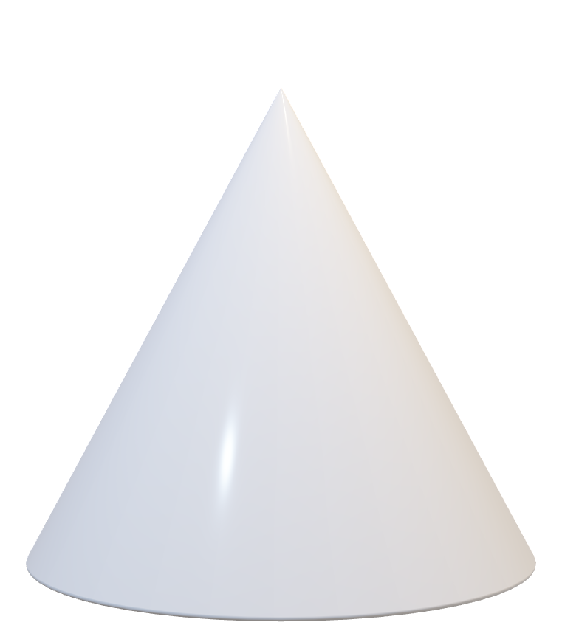
PannerNode
Sound cone
PannerNode’s position vector
PannerNode’s direction vector
Origin of coordinate system

Slide 10
Sound Cones
sound projection with inner and outer cones
sound intensity is function of angle from source’s orientation vector
source pointing at listener louder than pointed off-axis
source can be omni-directional
Orientation
Listener
Gain=1
coneInnerAngle
Variable gain
coneOuterAngle
coneOuterGain
Panner
Here,
coneInnerAngle=60
coneOuterAngle=120

Slide 11
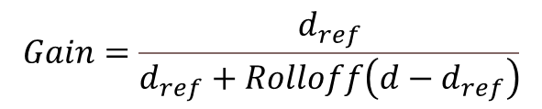
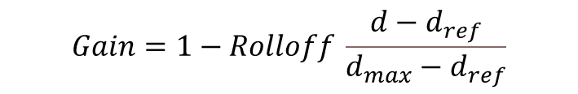
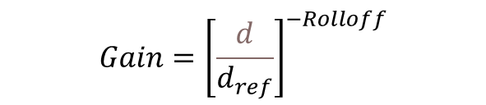
Distance models and rolloff
Linear
Inverse
Exponential
$$Gain=1−Rolloff \frac{d−d_{ref}}{d_{max}−d_{ref}}$$
Gain=1
Gain=1-Rolloff
Source
refDistance
Listener
maxDistance
$$Gain=\frac{d_{ref}}{d_{ref}+Rolloff\left(d−d_{ref}\right)}$$
Gain=1
Source
refDistance
Listener
$$Gain={\left[\frac{d}{d_{ref}}\right]}^{−Rolloff}$$
Gain=1
Source
refDistance
Listener

Slide 12

And finally, panning model
equalpower:
Default
Same algorithm as StereoPanner
Represents the equal-power panning algorithm
simple and efficient
HRTF
HRTF stands for Head-Related Transfer Function
Great for headphones
More computational
uses convolution with measured impulse responses from human subjects at many source angles
HRTF panning
Azimuth
Elevation
Unpanned source
HRTF impulse response database
Left IR
Right IR
Left channel convolution
Right channel convolution
L
R

Slide 13
Put it all together
Find distance between source and listener
Apply gain based on distance, distance model, reference distance, rolloff and max distance
Find angle between source and listener
Apply gain based on coneInnerAngle, coneOuterAngle, and coneOuterGain
Find azimuth (horizontal plane) and elevation angles between listener’s forward direction and source location
Apply gain based on panning model
The user doesn’t have to calculate any of this, just enter parameters

Slide 14
EXTRA
AudioListener
Left channel
Input source
Distance
Sound cone
Panning
Right channel
PannerNode parameters
coneInnerAngle
coneOuterAngle
coneOuterGain
orientationX
orientationY
orientationZ
positionX
positionY
positionZ
distanceModel
rolloffFactor
refDistance
maxDisrance
panningModel

Slide 15
Example
Source
(0,0,-1)
Position (0,0,-1)
Orientation (0,0,1)
coneInnerAngle= 45
coneOuterAngle= 90
coneOuterGain= 0.1
refDistance= 0.5
Listener set to defaults
x
z
Listener
(0,0, 0)

